Slide 2
.NET ❤️’s WebAssembly in .NET 7
Daniel Roth | @danroth27
Principal Product Manager
Microsoft

Slide 3




Make it fast!
https://...
Support all the .NET APIs!
?
How about debugging?
And the browser APIs too!
We need Hot Reload!
But keep it small!

Slide 4


.NET on WebAssembly in .NET 7
Enhanced debugging
Hot reload improvements
Expanded web crypto
WebAssembly SIMD & exception handling
Improved JavaScript interop
Multithreading (preview)
get.dot.net/7

Slide 5
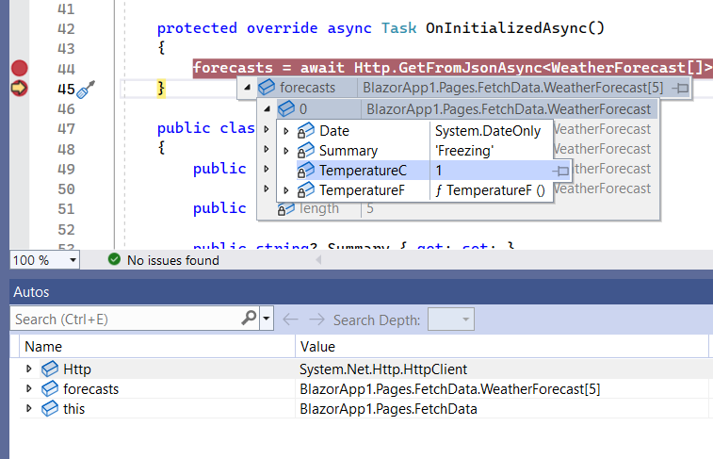
WebAssembly Debugging improvements
Just My Code
Inspect multidimensional arrays
Call Stack window shows correct name for async methods
Improved expression evaluation
Correct handling of the new keyword on derived members
Support for debugger-related attributes in System.Diagnostics
General reliability improvements

Slide 6
Demo
Debugging improvements

Slide 7
Hot reload improvements
🔥 Add new types
🔥 Add nested classes
🔥 Add static and instance methods to existing types
🔥 Add static fields and methods to existing types
🔥 Add static lambdas to existing methods
🔥 Add lambdas that capture this to existing methods that already captured this previously

Slide 8

Expanded web crypto
SHA1, SHA256, SHA384, SHA512
HMACSHA1, HMACSHA256, HMACSHA384, HMACSHA512
Rfc2898DeriveBytes (PBKDF2)
HKDF

Slide 9
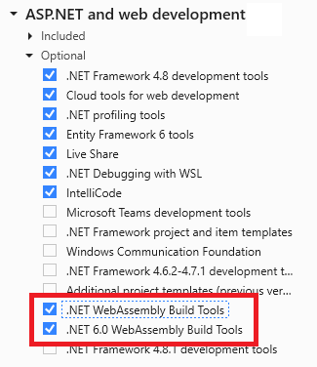
.NET SDK tooling for WebAssembly
.NET WebAssembly build tools: Ahead-of-time (AOT) compilation, runtime relinking, and native dependencies
dotnet workload install wasm-tools for .NET 7 projects
dotnet workload install wasm-tools-net6 for .NET 6 projects
.NET WebAssembly experimental tooling: Experimental .NET WebAssembly project templates and multithreading
dotnet workload install wasm-experimental

Slide 10
.NET WebAssembly AOT compilation improvements
Improved performance with WebAssembly Exception Handling & SIMD
<WasmEnableExceptionHandling>true</WasmEnableExeptionHandling>
<WasmEnableSIMD>true</WasmEnableSIMD> (not supported in Safari yet)

Slide 11
Improved JavaScript interop
New strongly typed JavaScript interop mechanism optimized for running on WebAssembly
Replaces IJSUnmarshelledRuntime
Continue to use IJSRuntime in Blazor for general purpose JavaScript interop
Import dotnet.js to run .NET from any JavaScript code
Use [JSimport] to import JavaScript functions into .NET
Use [JSExport] to export .NET methods to JavaScript
Rich programming model for type marshalling
Supports sync & async, callbacks, Tasks & Promises, proxy objects
In Blazor apps:
Use JSHost.ImportAsync to import JavaScript modules into your .NET code
Use getDotnetRuntime(0) to access the .NET runtime from JavaScript

Slide 12
Demo
Improved JavaScript interop

Slide 13
Multithreading (preview)
Browsers are typically single threaded
Emulate .NET threads using a pool of web workers and shared array buffers
Enable by installing the wasm-experimental workload and setting the WasmEnableThreads MSBuild property
Requires cross-origin isolation
Not supported in Blazor yet – use the experimental .NET WebAssembly project templates

Slide 14
Demo
Multithreading

Slide 15

Uno Platform .NET 7 Experience
20% - 50% performance boost in critical paths overall
WebAssembly exceptions handling (2x compared to .NET 6)
Faster AOT exception handling (25x compared to .NET 6)
2x improvement in interop code using JSImport/JSExport
Smooth UI updates via support for experimental threading
More detail in Jerome Laban’s (CTO, Uno Platform) session (Fri: 14:30 - 15:00 PST)
https://platform.uno

Slide 16
.NET on WebAssembly in .NET 7
Enhanced debugging
Hot reload improvements
Expanded web crypto
WebAssembly SIMD & exception handling
Improved JavaScript interop
Multithreading (preview)
get.dot.net/7

Slide 17


Thank You!
Let's build amazing apps with .NET 7 get.dot.net/7

